Slide 1

Aesop/I Visions Training
Annex 11/14/2012

Slide 2
I Visions – log on
First step is to log onto I Vision. Use: https://townships.wmgiv.net/prairiehills144ivisions/
See next page for main screen you will get when going to this website
Click log in
Note: if you have problems logging on – contact Ms. Alison Brown at ext 2125 or email at albrown@phsd144.net

Slide 3
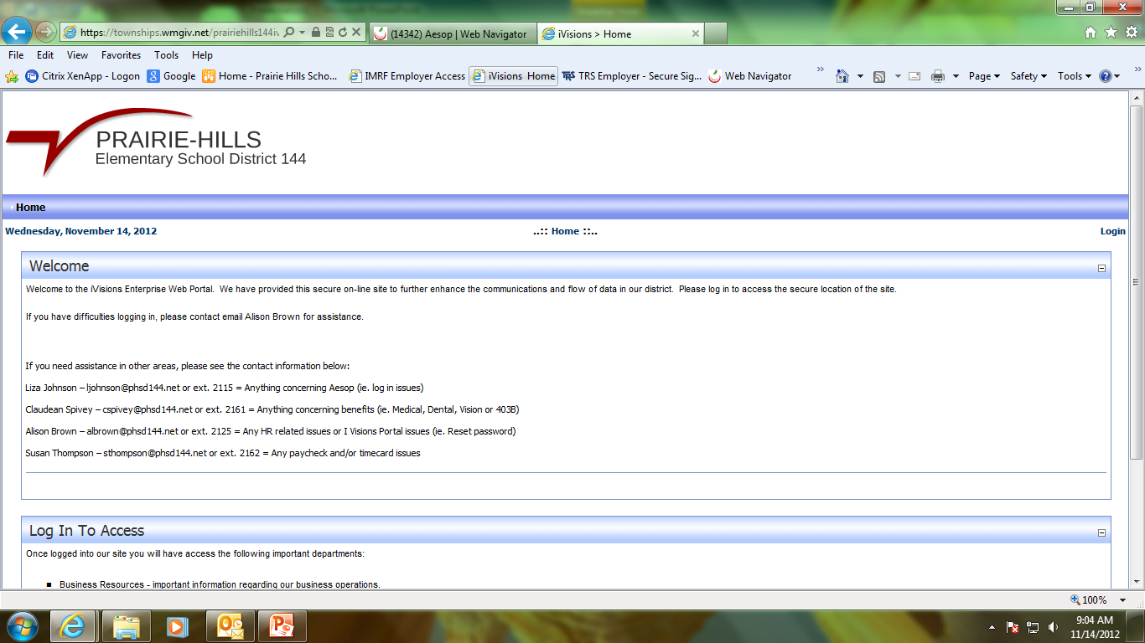
If you have questions or issues,
Please contact the appropriate person
See left

Slide 4
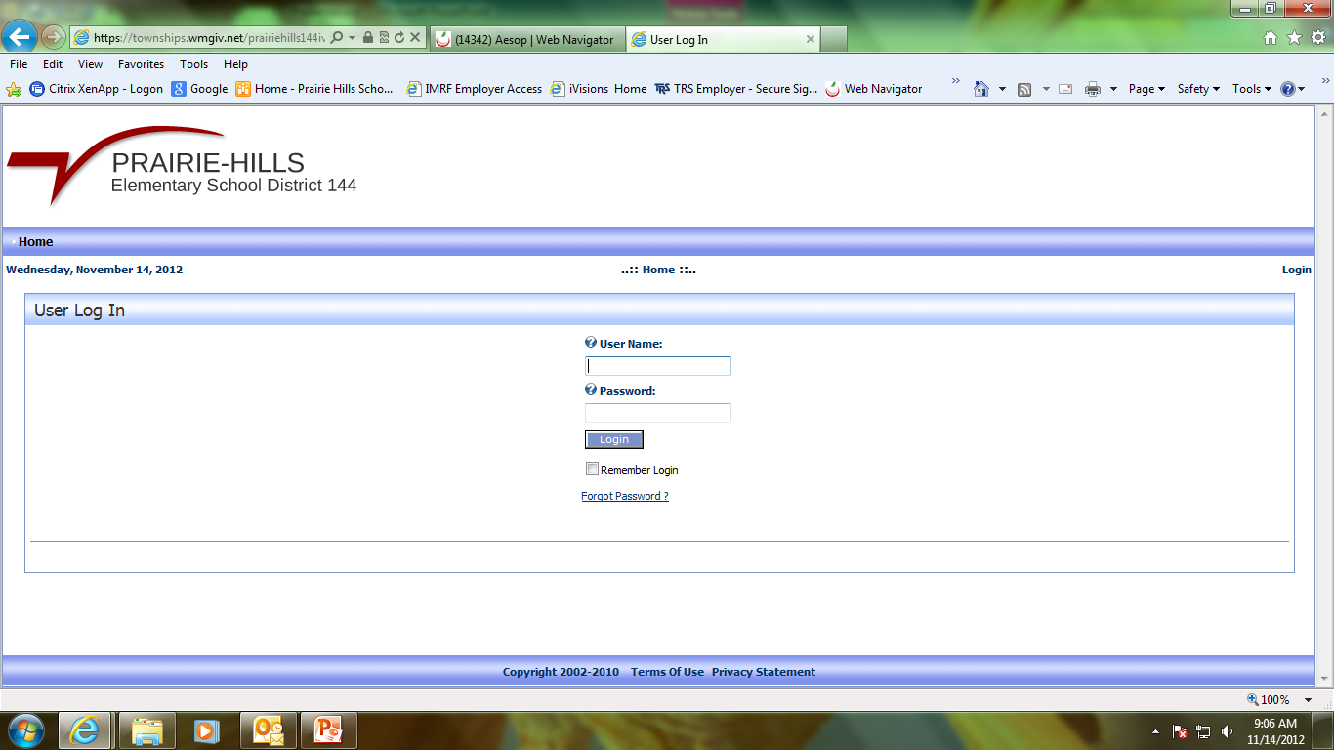
Type in your user name (usually first initial and last name)
Then type in password.
Click login

Slide 5
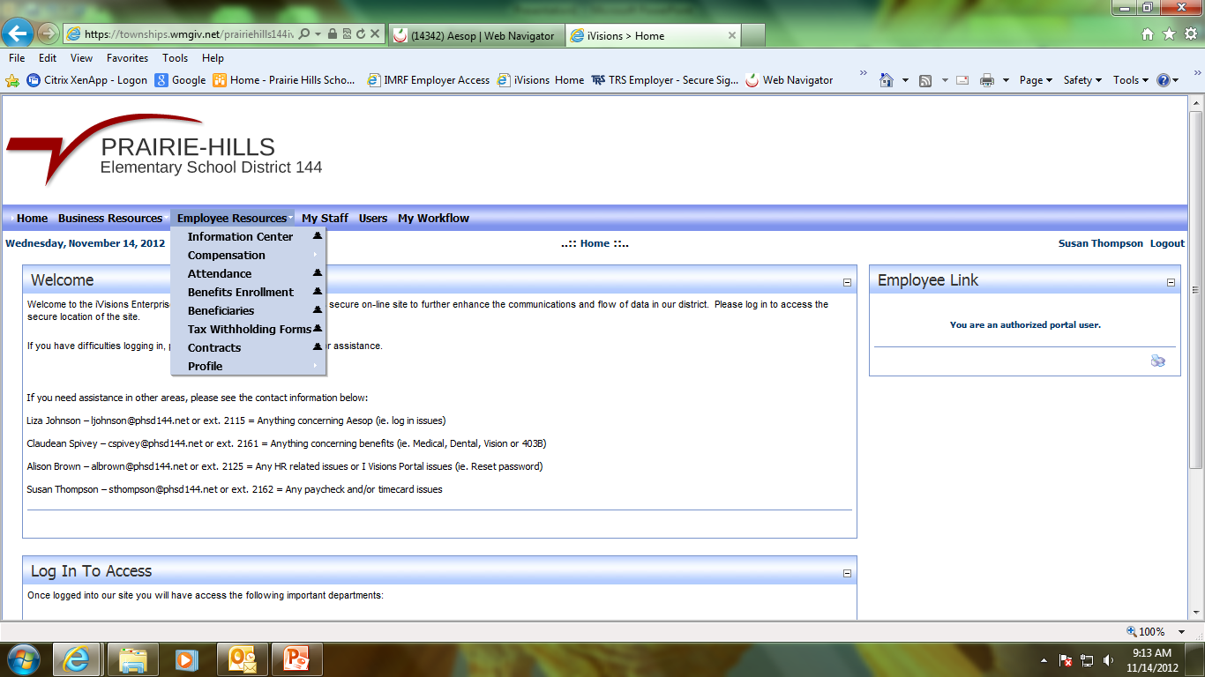
First place to go is Employee Resources, from there you can see payroll (compensation), attendance, tax forms and profile

Slide 6
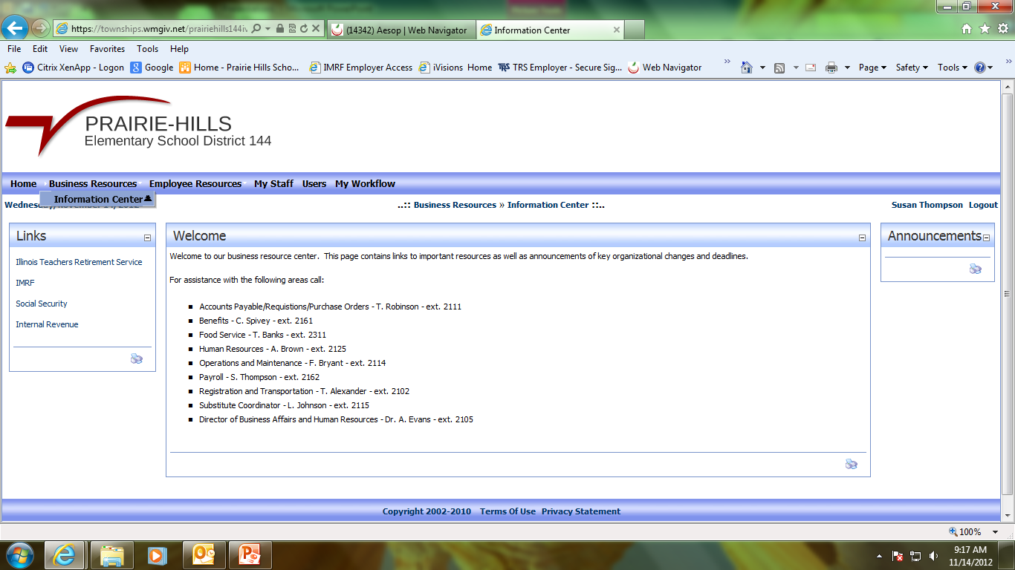
Under Business Resources you will find links to IMRF, TRS, SS and IRS You will also find announcements from the district and again contact Information for questions/issues

Slide 7
AESOP
ALL ABSENCES MUST BE ENTERED WITHIN AESOP
In addition to Aesop, a paper form must also be completed.
Personal days must be “pre-approved”
Secretary of each building will keep the forms and will be able to let you know which ones you will need

Slide 8
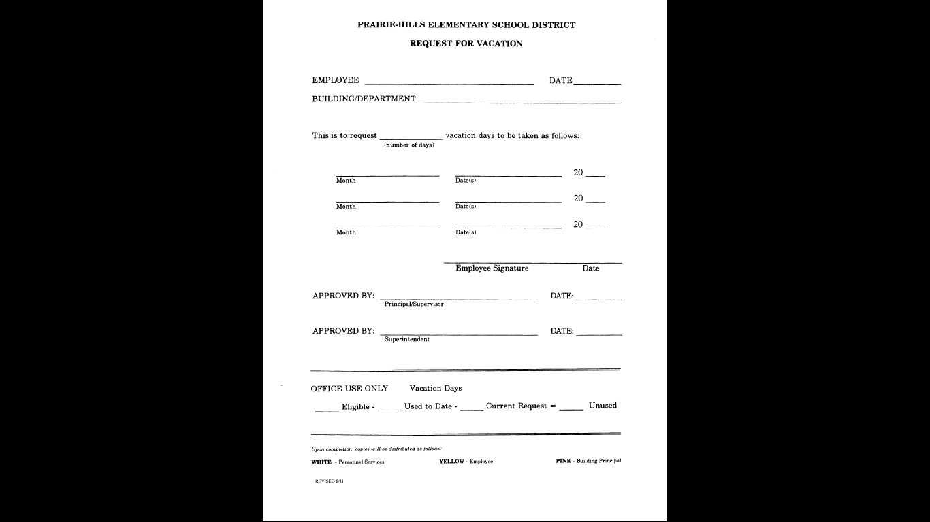
This form is used
For VACATION
Requests only
It must be filled out
In ADVANCE and
Approved by the
PRINCIPAL and the
SUPERINTENDENT
Once form is approved
It is sent to payroll for processing.
These forms are then matched against what was entered into Aesop

Slide 9
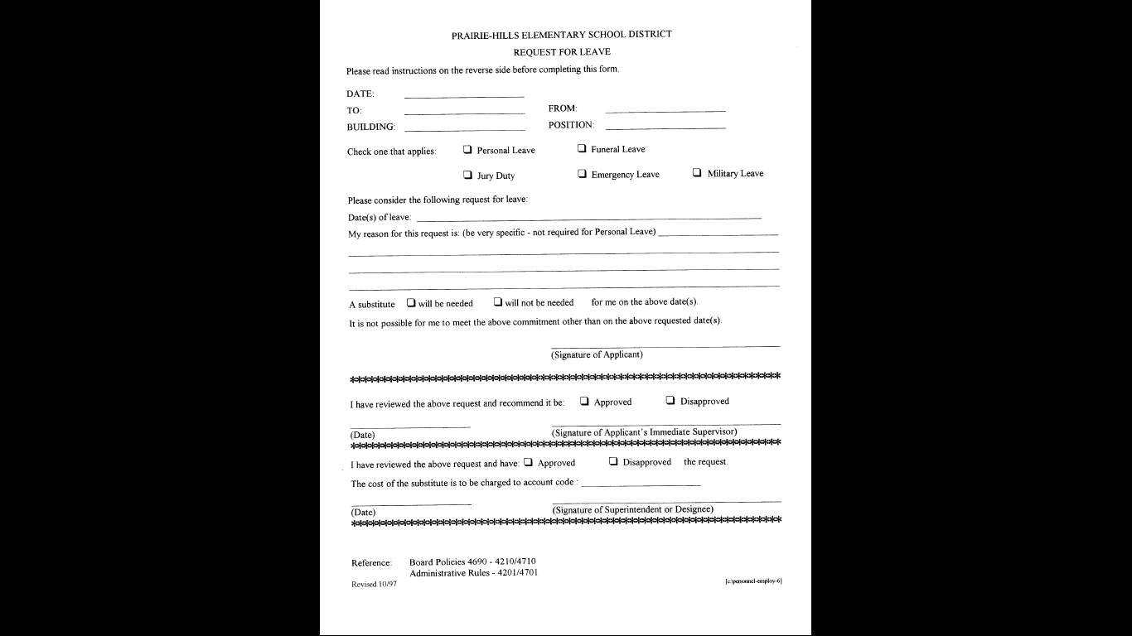
This is a REQUEST FOR LEAVE
MUST BE COMPLETED ~
PRIOR TO LEAVE
Step 2 – must email or call
The secretary of superintendent
For this form you MUST have a
Verbal authorization!
This form is also approved by the
Principal and superintendent.

Slide 10
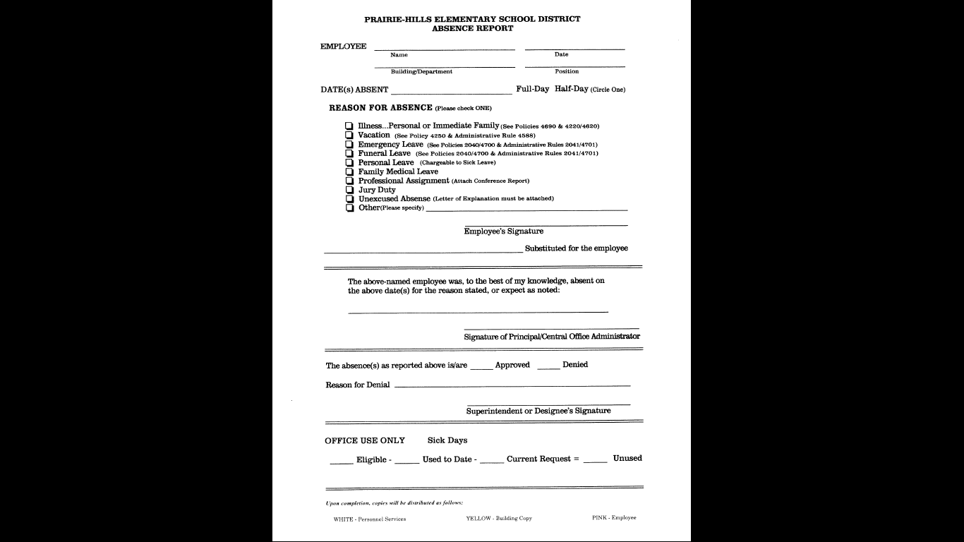
The ABSENCE REPORT FORM
Is completed upon a RETURN
From ANY type of absence.
This form must have your
Signature, be approved by
The principal & superintendent
Once approved it is given to
Payroll to process. This form
Is then checked against Aesop

Slide 11
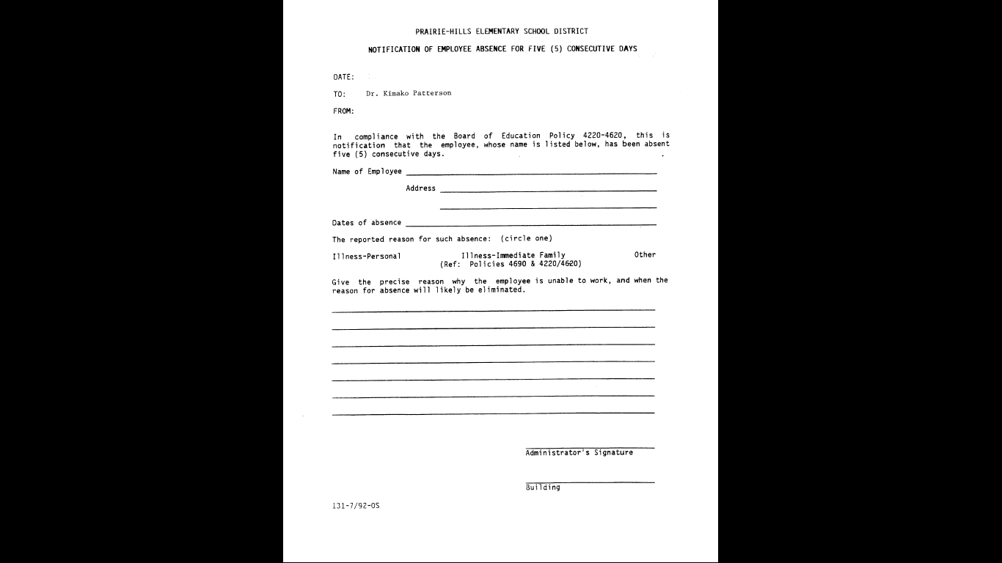
If for any reason you are out
5 consecutive days – this
Notice will be filled out by
The secretary of the building,
Approved by the principal and
Sent to the superintendent
This form MUST have Legal name,
Complete address and all dates of
Absence.
NOTE: 5 consecutive days can be
Wed, Thurs, Fri, Mon, Tues (day 5)

Slide 12
Log on to Aesop
http://www.frontlinek12.com/Products/Aesop.html
The above link will get you to the login screen of Aesop
NOTES:

Slide 13
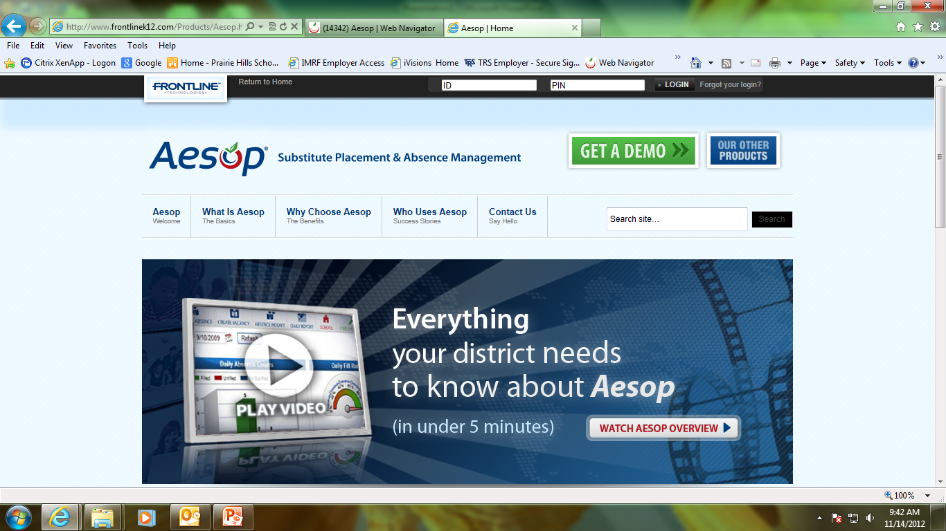

Slide 14
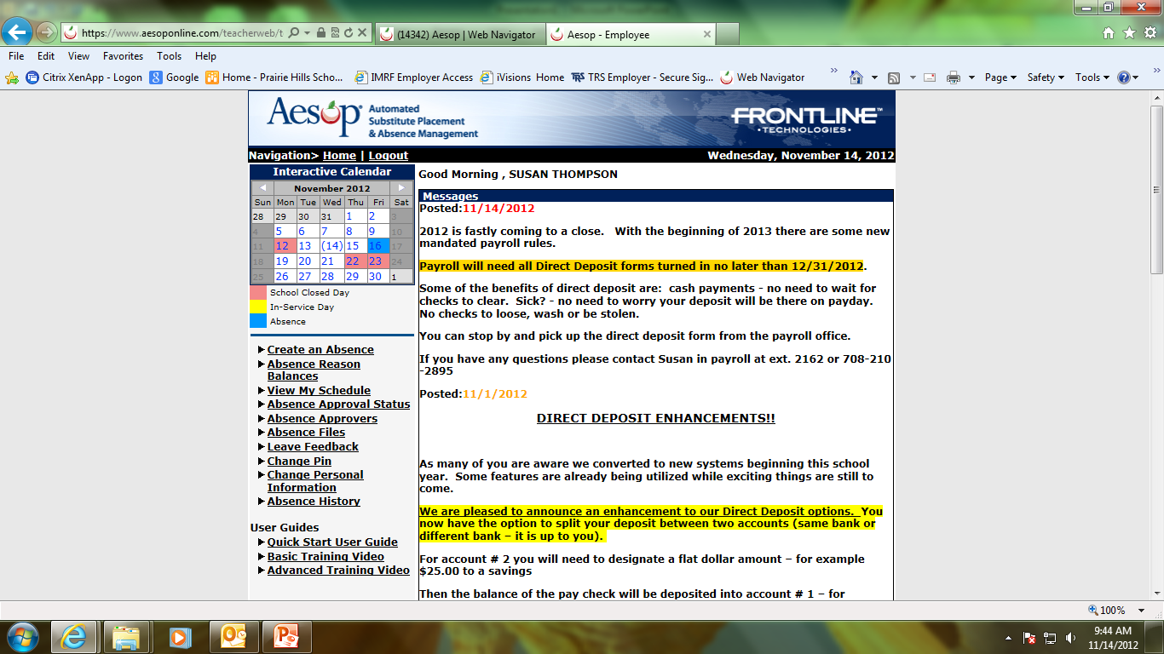
This is the home page
Here is where you create
An absence
You also will see messages
From the district
There are user guides at the bottom, we do suggest you view all of them.

Slide 15
Notes

